Slide 1
Overview of Relational Database Design

Slide 2
Outline
Decomposition
Functional Dependency
Decomposition Using Functional Dependency

Slide 3
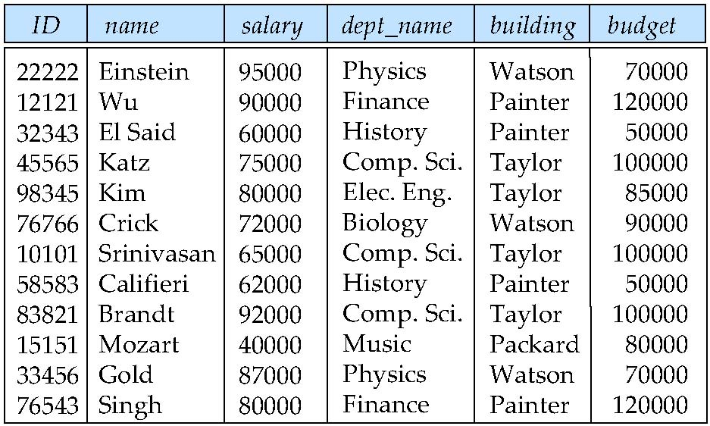
Example of a Bad Schema
Consider a relation inst_dept, which represents the result of a natural join on the relations corresponding to instructor and department
This relation is in “bad form” since there is a possibility of repetition of information and we may need to use null values to represent information.

Slide 4
How to Deal with a Bad Schema?
How do we deal with a bad schema? Split the scheme up (decompose) into a number of smaller schemas.
Hopefully, each of the smaller schemes is in a “good form”; that is, there is no repetition of information and there is no need to use null values.
In the case of the inst_dept schema , we would decompose it into two relation schemes – instructor and department .
We know that both instructor and department are in good form (how do we know this)?

Slide 5
Lossless-Join Decomposition
When we decompose a relation r into two relations r₁ and r₂ we must make sure that we can reconstruct the information that r contained. Reconstruction is achieved by using the natural-join operation
Decomposition of r = (A, B, C) r₁ = (A, B) r₂ = (B, C)
A
B
C
A
B
B
C
α
β
1
2
A
B
α
β
1
2
1
2
A
B
r
∏_{A,B}(r)
∏_{B,C}(r)
A
B
C
∏_{A} (r) ∏_{B} (r)
α
β
1
2
A
B

Slide 6
Decomposition does not always work
Not all compositions are lossless-join decomposition
Suppose we decompose
employee(ID, name, street, city, salary) into
employee1 (ID, name)
employee2 (name, street, city, salary)
The next slide shows how we lose information -- we cannot reconstruct the original employee relation using employee1 and employee2 -- and so, this is a lossy decomposition.

Slide 7
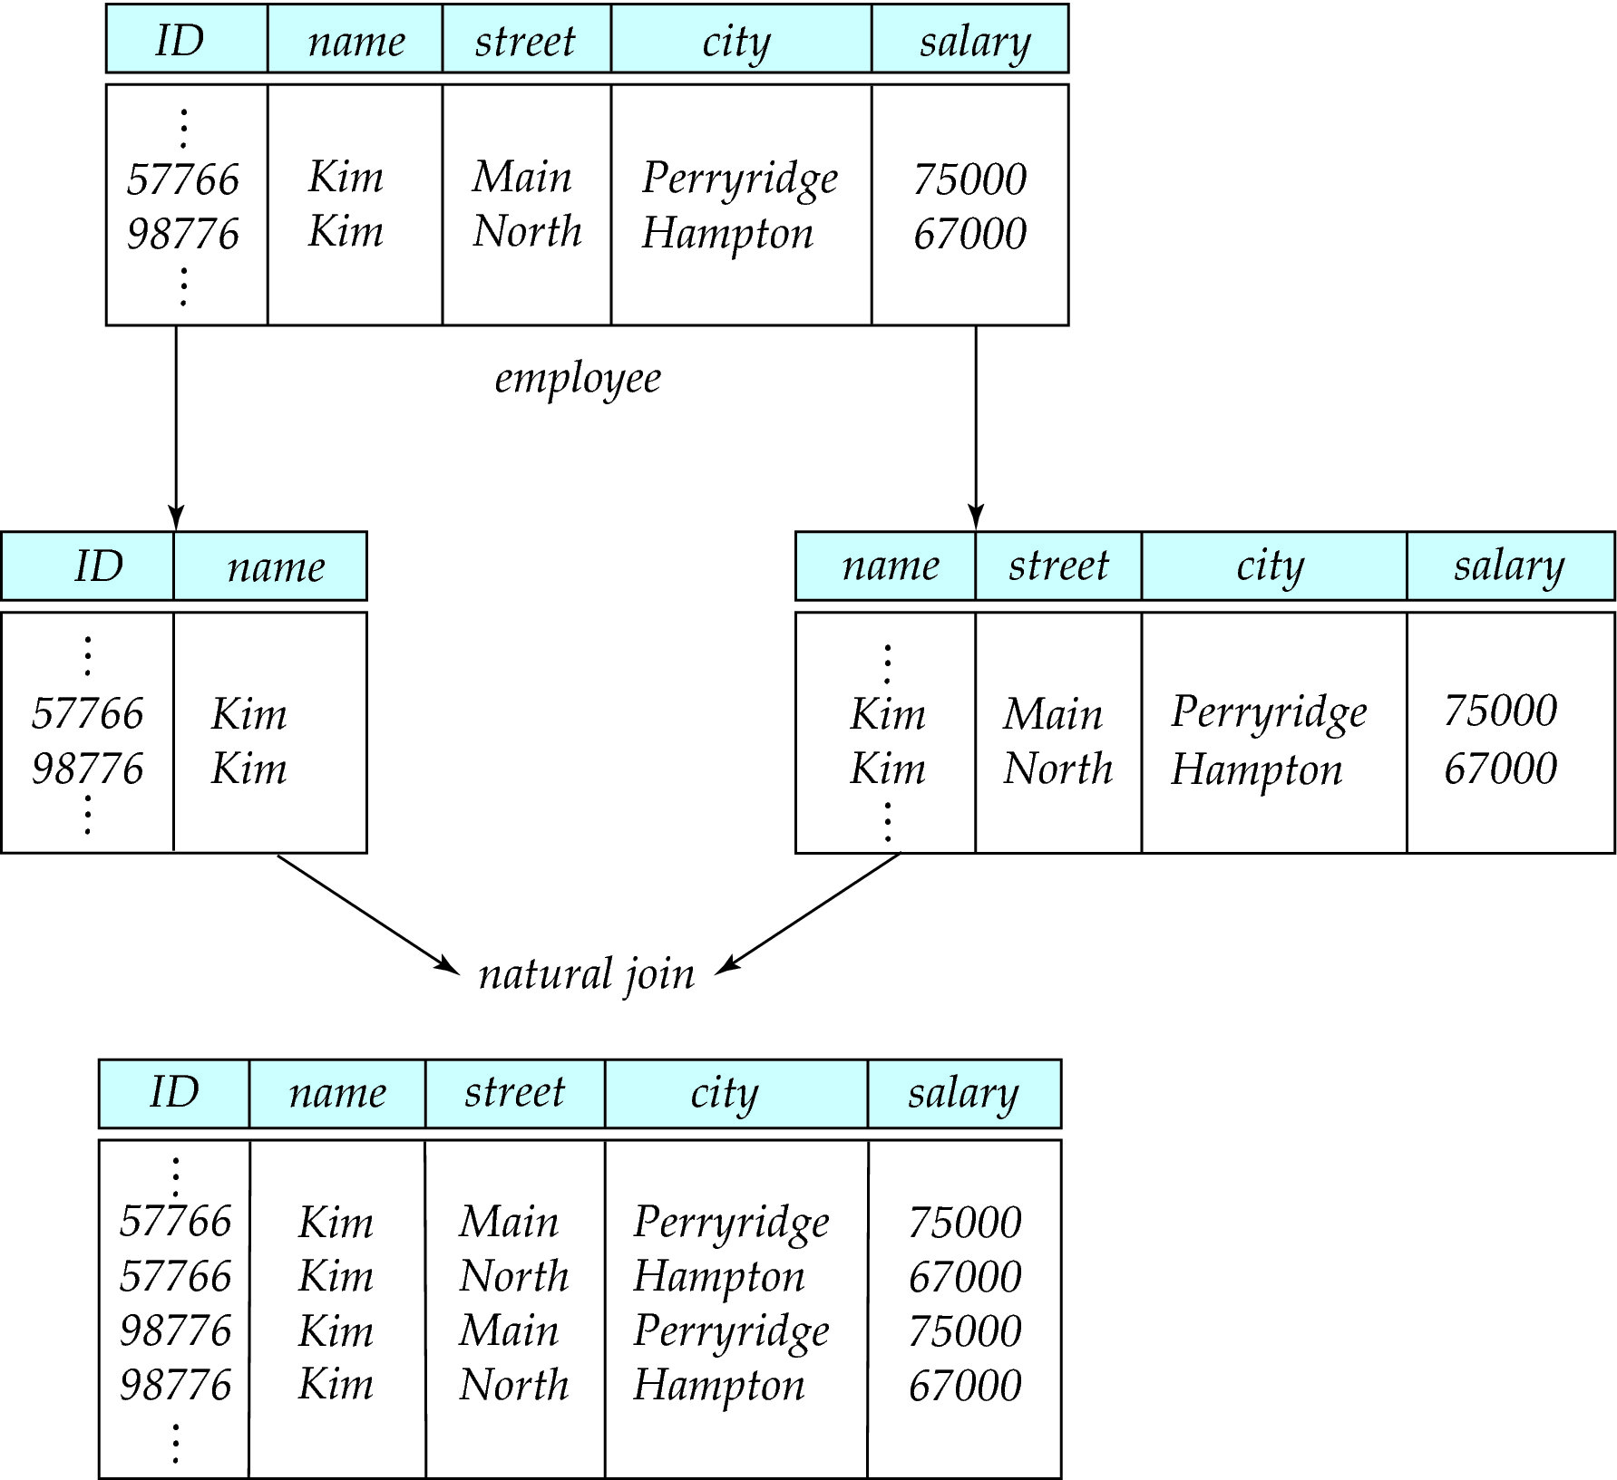
A Lossy Decomposition

Slide 8
Lossless-Join Decomposition Definition
Let R be a relation schema, and let R₁ and R₂ form a decomposition of R.
We say that the decomposition is a lossless decomposition if there is no loss of information by replacing R with two relation schemas R₁ and R₂ .
More precisely, we say the decomposition is lossless if, for all legal database instances (this is, all possible relations r on schema R)
r = ∏_{R1} (r ) ∏_{R2} (r )
We will define “legal database instances” later on.

Slide 9
Decomposition Theory
Goal — Devise a Theory for the Following:
Decide whether a particular relation R is in “good” form.
In the case that a relation R is not in “good” form, decompose it into a set of relations {R₁, R₂, ..., R_{n}} such that
each relation is in good form
the decomposition is a lossless-join decomposition
Our theory is based on:
functional dependencies
multivalued dependencies

Slide 10
Functional Dependencies

Slide 11
Functional Dependencies
Constraints on the set of legal relations.
Require that the value for a certain set of attributes determines uniquely the value for another set of attributes.
A functional dependency is a generalization of the notion of a key.

Slide 12
Functional Dependencies (Cont.)
Let R be a relation schema, and let:
α ⊆ R and β ⊆ R
The functional dependency
α → β
holds on R if and only if for any legal relations r(R), whenever any two tuples t₁ and t₂ of r agree on the attributes α, they also agree on the attributes β. That is,
t₁[α] = t₂ [α] ⇒ t₁[β ] = t₂ [β ]
Example: Consider r(A,B ) with the following instance of r.
On this instance, A → B does NOT hold, but B → A does hold.
A
B
1
1
3
4
5
7

Slide 13
Functional Dependencies (Cont.)
K is a superkey for relation schema R if and only if
K → R
K is a candidate key for R if and only if
K → R, and
for no α ⊂ K, α → R
Functional dependencies allow us to express constraints that cannot be expressed using superkeys. Consider the schema:
inst_dept (ID, name, salary, dept_name, building, budget ).
We expect these two functional dependencies to hold:
dept_name→ building
ID → building
but would not expect the following to hold:
dept_name → salary

Slide 14
Use of Functional Dependencies
We use functional dependencies to:
Test relations to see if they are legal under a given set of functional dependencies.
If a relation r is legal under a set F of functional dependencies, we say that r satisfies F.
specify constraints on the set of legal relations
We say that F holds on R if all legal relations on R satisfy the set of functional dependencies F.
Note: A specific instance of a relation schema may satisfy a functional dependency even if the functional dependency does not hold on all legal instances.
For example, a specific instance of instructor may, by chance, satisfy
name → ID

Slide 15
Trivial Functional Dependencies
A functional dependency is trivial if it is satisfied by all instances of a relation
Example:
ID, name → ID
name → name
In general, α → β is trivial if β ⊆ α

Slide 16
Closure of a Set of Functional Dependencies
Given a set F of functional dependencies, there are certain other functional dependencies that are logically implied by F.
For example: If A → B and B → C, then we can infer that A → C
The set of all functional dependencies logically implied by F is the closure of F.
We denote the closure of F by F⁺.
F⁺ is a superset of F.

Slide 17
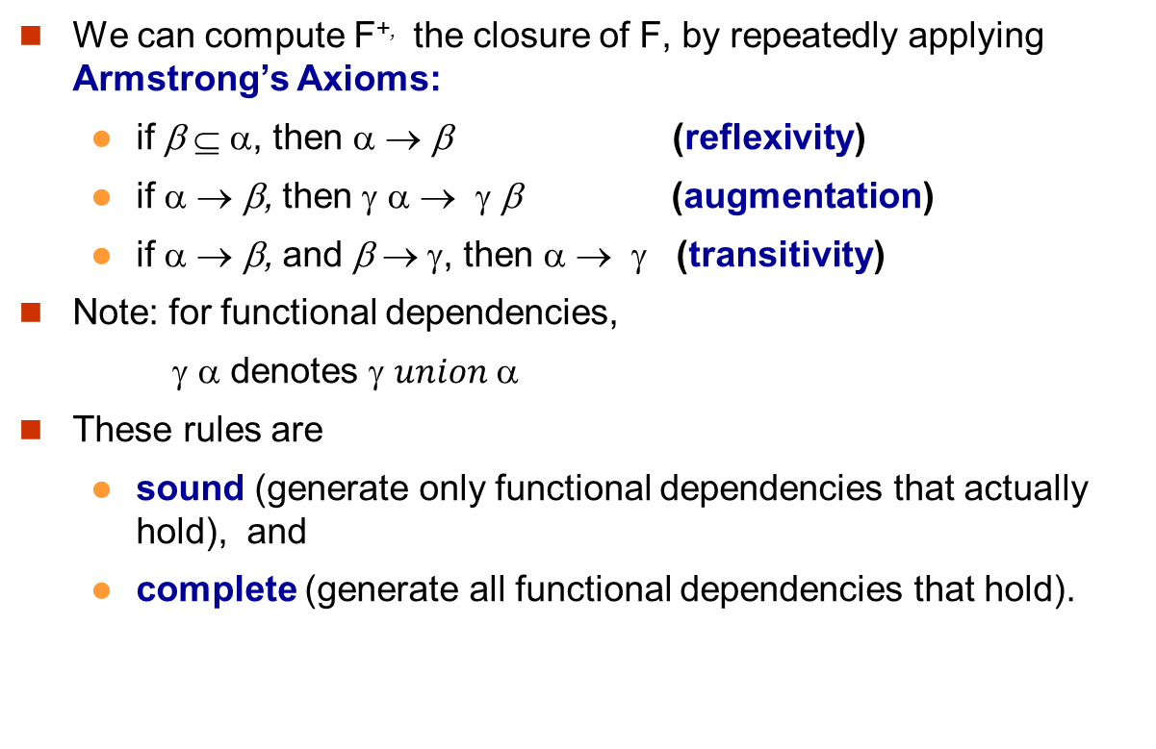
Computing F⁺

Slide 18
Example of Armstrong’s Axioms
R = (A, B, C, G, H, I) F = { A → B A → C CG → H CG → I B → H }
some members of F⁺
A → H
by transitivity from A → B and B → H
AG → I
by augmenting A → C with G, to get AG → CG and then transitivity with CG → I
CG → HI
by augmenting CG → I to infer CG → CGI,
and augmenting of CG → H to infer CGI → HI,
and then transitivity

Slide 19
Procedure for Computing F⁺
F ⁺ = F repeat for each functional dependency f in F⁺ apply reflexivity and augmentation rules on f add the resulting functional dependencies to F ⁺ for each pair of functional dependencies f₁and f₂ in F ⁺ if f₁ and f₂ can be combined using transitivity then add the resulting functional dependency to F ⁺ until F ⁺ does not change any further
NOTE: We shall see an alternative procedure for this task later

Slide 20
Closure of Attribute Sets
Given a set of attributes α, define the closure of α under F (denoted by α⁺) as the set of attributes that are functionally determined by α under F
Algorithm to compute α⁺, the closure of α under F
result := α; while (changes to result) do for each β → γ in F do begin if β ⊆ result then result := result ∪ γ end

Slide 21
Example of Attribute Set Closure
R = (A, B, C, G, H, I)
F = {A → B A → C CG → H CG → I B → H}
(AG)⁺
1. result = AG
2. result = ABCG (A → C and A → B)
3. result = ABCGH (CG → H and CG ⊆ AGBC)
4. result = ABCGHI (CG → I and CG ⊆ AGBCH)
Is AG a candidate key?
Is AG a super key?
Does AG → R? == Is (AG)⁺ ⊇ R
Is any subset of AG a superkey?
Does A → R? == Is (A)⁺ ⊇ R
Does G → R? == Is (G)⁺ ⊇ R

Slide 22
Uses of Attribute Closure
There are several uses of the attribute closure algorithm:
Testing for superkey:
To test if α is a superkey, we compute α^{+,} and check if α⁺ contains all attributes of R.
Testing functional dependencies
To check if a functional dependency α → β holds (or, in other words, is in F⁺), just check if β ⊆ α⁺.
That is, we compute α⁺ by using attribute closure, and then check if it contains β.
Is a simple and cheap test, and very useful
Computing closure of F
For each γ ⊆ R, we find the closure γ⁺, and for each S ⊆ γ⁺, we output a functional dependency γ → S.

Slide 23
Canonical Cover
Sets of functional dependencies may have redundant dependencies that can be inferred from the others
For example: A → C is redundant in: {A → B, B → C, A→ C}
Parts of a functional dependency may be redundant
E.g.: on RHS: {A → B, B → C, A → CD} can be simplified to {A → B, B → C, A → D}
E.g.: on LHS: {A → B, B → C, AC → D} can be simplified to {A → B, B → C, A → D}
Intuitively, a canonical cover of F, denoted by F_{c} is a “minimal” set of functional dependencies equivalent to F, having no redundant dependencies or redundant parts of dependencies.
We show how to compute F_{c} later.

Slide 24
Extraneous Attributes
Consider a set F of functional dependencies and the functional dependency α → β in F.
Attribute A is extraneous in α if A ∈ α and F logically implies (F – {α → β}) ∪ {(α – A) → β}.
Attribute A is extraneous in β if A ∈ β and the set of functional dependencies (F – {α → β}) ∪ {α →(β – A)} logically implies F.
Note: implication in the opposite direction is trivial in each of the cases above, since a “stronger” functional dependency always implies a weaker one
Example: Given F = {A → C, AB → C }
B is extraneous in AB → C because {A → C, AB → C} logically implies A → C (I.e. the result of dropping B from AB → C).
Example: Given F = {A → C, AB → CD}
C is extraneous in AB → CD since AB → C can be inferred even after deleting C

Slide 25
Testing if an Attribute is Extraneous
Consider a set F of functional dependencies and the functional dependency α → β in F.
To test if attribute A ∈ α is extraneous in α
compute ({α} – A)⁺ using the dependencies in F
check that ({α} – A)⁺ contains β; if it does, A is extraneous in α
To test if attribute A ∈ β is extraneous in β
compute α⁺ using only the dependencies in F’ = (F – {α → β}) ∪ {α →(β – A)},
check that α⁺ contains A; if it does, A is extraneous in β

Slide 26
Computing a Canonical Cover
R = (A, B, C) F = {A → BC B → C A → B AB → C}
Combine A → BC and A → B into A → BC
Set is now {A → BC, B → C, AB → C}
A is extraneous in AB → C
Check if the result of deleting A from AB → C is implied by the other dependencies
Yes: in fact, B → C is already present!
Set is now {A → BC, B → C}
C is extraneous in A → BC
Check if A → C is logically implied by A → B and the other dependencies
Yes: using transitivity on A → B and B → C.
Can use attribute closure of A in more complex cases
The canonical cover is: A → B B → C

Slide 27
Decomposition Using Functional Dependency

Slide 28
Lossless-join Decomposition
We can now formally define lossless-join decomposition.
Let R be a relation schema, and let R₁ and R₂ form a decomposition of R. For the case of R = (R₁, R₂), we require that for all possible relations r on schema R
r = ∏_{R1} (r ) ∏_{R2} (r )
A decomposition of R into R₁ and R₂ is lossless join if at least one of the following dependencies is in F⁺:
R₁ ∩ R₂ → R₁
R₁ ∩ R₂ → R₂

Slide 29
Example
R = (A, B, C) F = {A → B, B → C)
R₁ = (A, B), R₂ = (B, C)
Lossless-join decomposition:
R₁ ∩ R₂ = {B} and B → BC
R₁ = (A, B), R₂ = (A, C)
Lossless-join decomposition:
R₁ ∩ R₂ = {A} and A → AB

Slide 30
Dependency Preserving Decomposition
Constraints, including functional dependencies, are costly to check (when one updates or inserts new tuples) unless they pertain to only one relation
It is desirable to be able to test only those dependencies on each individual relation of a decomposition in order to ensure that all functional dependencies hold.
A decomposition is dependency preserving If it is sufficient to test only those dependencies on each individual relation of a decomposition in order to ensure that all functional dependencies hold.

Slide 31
Testing for Dependency Preservation
To check if a dependency α → β is preserved in a decomposition of R into R₁, R₂, …, R_{n} we apply the following test (with attribute closure done with respect to F)
result = α while (changes to result) do for each R_{i} in the decomposition t = (result ∩ R_{i})⁺ ∩ R_{i} result = result ∪ t
If result contains all attributes in β, then the functional dependency α → β is preserved.
We apply the test on all dependencies in F to check if a decomposition is dependency preserving
This procedure takes polynomial time, instead of the exponential time required to compute F⁺ and (F₁ ∪ F₂ ∪ … ∪ F_{n})⁺

Slide 32
Example
R = (A, B, C) F = {A → B, B → C)
R₁ = (A, B), R₂ = (B, C)
Lossless-join decomposition:
R₁ ∩ R₂ = {B} and B → BC
Dependency preserving
R₁ = (A, B), R₂ = (A, C)
Lossless-join decomposition:
R₁ ∩ R₂ = {A} and A → AB
Not dependency preserving (cannot check B → C without computing R₁ R₂)

Slide 33
What do we Have Thus Far?
We know how to test to see if the decomposition of a relation into a set of relations a lossless-join decomposition.
We know that any acceptable decomposition must be a lossless-join decomposition.
We know that is desirable to have a lossless-join decomposition that is dependency preserving.
We do NOT know (yet) on how to decide if a given relation is in good form.

